Slide 1
Processor Design
5Z032
Instructions: Language of the Computer
Henk Corporaal
Eindhoven University of Technology
2011

Slide 2
Topics
Instructions & MIPS instruction set
Where are the operands ?
Machine language
Assembler
Translating C statements into Assembler
Other architectures:
  PowerPC
  Intel 80x86
More complex stuff, like:
  while statement
  switch statement
  procedure / function (leaf and nested)
  stack
  linking object files

Slide 3
Instructions:
Language of the Machine
More primitive than higher level languages
e.g., no sophisticated control flow
Very restrictive
e.g., MIPS Arithmetic Instructions
We’ll be working with the MIPS instruction set architecture
  similar to other architectures developed since the 1980's
  used by NEC, Nintendo, Silicon Graphics, Sony
Design goals: maximize performance and minimize cost, reduce design time, reduce energy consumption

Slide 4
Main Types of Instructions
Arithmetic
  Integer
  Floating Point
Memory access instructions
  Load & Store
Control flow
  Jump
  Conditional Branch
  Call & Return

Slide 5
MIPS arithmetic
Most instructions have 3 operands
Operand order is fixed (destination first)
Example:
C code: A = B + C
MIPS code: add $s0, $s1, $s2
($s0, $s1 and $s2 are associated with variables by compiler)

Slide 6
MIPS arithmetic
C code: A = B + C + D;
E = F - A;
MIPS code: add $t0, $s1, $s2
add $s0, $t0, $s3
sub $s4, $s5, $s0
Operands must be registers, only 32 registers provided
Design Principle: smaller is faster. Why?

Slide 7
Registers vs. Memory
Arithmetic instructions operands must be registers,
— only 32 registers provided
Compiler associates variables with registers
What about programs with lots of variables ?
Memory
CPU
register file
IO

Slide 8
Register allocation
Compiler tries to keep as many variables in registers as possible
Some variables can not be allocated
  large arrays (too few registers)
  aliased variables (variables accessible through pointers in C)
  dynamic allocated variables
    heap
    stack
Compiler may run out of registers => spilling

Slide 9
Memory Organization
Viewed as a large, single-dimension array, with an address.
A memory address is an index into the array
"Byte addressing" means that the index points to a byte of memory.
0
8 bits of data
1
8 bits of data
2
8 bits of data
3
8 bits of data
4
8 bits of data
5
8 bits of data
6
8 bits of data
...

Slide 10
Memory Organization
Bytes are nice, but most data items use larger "words"
For MIPS, a word is 32 bits or 4 bytes.
2³² bytes with byte addresses from 0 to 2³²-1
2³⁰ words with byte addresses 0, 4, 8, ... 2³²-4
0
32 bits of data
4
Registers hold 32 bits of data
32 bits of data
8
32 bits of data
...
12
32 bits of data

Slide 11
Memory layout: Alignment
31
23
15
7
0
0
this word is aligned; the others are not!
4
8
12
address
16
20
24
Words are aligned
i.e., what are the least 2 significant bits of a word address?

Slide 12
Instructions
Load and store instructions
Example:
C code: A[8] = h + A[8];
MIPS code: lw $t0, 32($s3)
add $t0, $s2, $t0
sw $t0, 32($s3)
Store word operation has no destination (reg) operand
Remember arithmetic operands are registers, not memory!

Slide 13

Our First C Example
Can we figure out the code?
swap(int v[], int k);
{ int temp;
temp = v[k]
v[k] = v[k+1];
v[k+1] = temp;
}
swap:
muli $2 , $5, 4
add $2 , $4, $2
lw $15, 0($2)
lw $16, 4($2)
sw $16, 0($2)
sw $15, 4($2)
jr $31
Explanation:
index k : $5
base address of v: $4
address of v[k] is $4 + 4.$5

Slide 14
So far we’ve learned:
MIPS
— loading words but addressing bytes
— arithmetic on registers only
Instruction Meaning
add $s1, $s2, $s3 $s1 = $s2 + $s3
sub $s1, $s2, $s3 $s1 = $s2 – $s3
lw $s1, 100($s2) $s1 = Memory[$s2+100]
sw $s1, 100($s2) Memory[$s2+100] = $s1

Slide 15
Machine Language
Instructions, like registers and words of data, are also 32 bits long
  Example: add $t0, $s1, $s2
  Registers have numbers: $t0=9, $s1=17, $s2=18
Instruction Format:
op rs rt rd shamt funct
000000 10001 10010 01001 00000 100000
6 bits
5 bits
5 bits
5 bits
5 bits
6 bits
Can you guess what the field names stand for?

Slide 16
Machine Language
Consider the load-word and store-word instructions,
  What would the regularity principle have us do?
  New principle: Good design demands a compromise
Introduce a new type of instruction format
  I-type for data transfer instructions
  other format was R-type for register
Example: lw $t0, 32($s2)
35 18 9 32
op rs rt 16 bit number
Where's the compromise?
Study example page 119-120

Slide 17
Stored Program Concept
Instructions are bits
Programs are stored in memory
— to be read or written just like data
Fetch & Execute Cycle
  Instructions are fetched and put into a special register
  Bits in the register "control" the subsequent actions
  Fetch the “next” instruction and continue
memory for data, programs,
compilers, editors, etc.
Processor
Memory

Slide 18
Stored Program Concept
memory
OS
code
Program 1
data
CPU
unused
Program 2
unused

Slide 19
Control
Decision making instructions
  alter the control flow,
  i.e., change the "next" instruction to be executed
MIPS conditional branch instructions:
bne $t0, $t1, Label
beq $t0, $t1, Label
Example: if (i==j) h = i + j;
bne $s0, $s1, Label
add $s3, $s0, $s1
Label: ....

Slide 20
Control
MIPS unconditional branch instructions:
j label
Example:
if (i!=j) beq $s4, $s5, Lab1
h=i+j; add $s3, $s4, $s5
else j Lab2
h=i-j; Lab1: sub $s3, $s4, $s5
Lab2: ...
Can you build a simple for loop?

Slide 21
So far:
Instruction Meaning
add $s1,$s2,$s3 $s1 = $s2 + $s3
sub $s1,$s2,$s3 $s1 = $s2 – $s3
lw $s1,100($s2) $s1 = Memory[$s2+100]
sw $s1,100($s2) Memory[$s2+100] = $s1
bne $s4,$s5,L Next instr. is at Label if $s4 ° $s5
beq $s4,$s5,L Next instr. is at Label if $s4 = $s5
j Label Next instr. is at Label
Formats:
op rs rt rd shamt funct
R
I
J
op rs rt 16 bit address
op 26 bit address

Slide 22
Control Flow
We have: beq, bne, what about Branch-if-less-than?
New instruction:
if $s1 < $s2 then
$t0 = 1
slt $t0, $s1, $s2 else
$t0 = 0
Can use this instruction to build "blt $s1, $s2, Label"
— can now build general control structures
Note that the assembler needs a register to do this,
— use conventions for registers

Slide 23
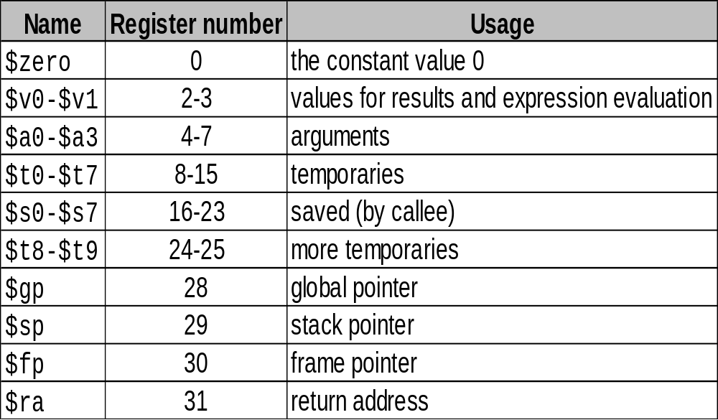
Used MIPS Conventions

Slide 24
Constants
Small constants are used quite frequently (50% of operands) e.g., A = A + 5;
B = B + 1;
C = C - 18;
Solutions? Why not?
  put 'typical constants' in memory and load them
  create hard-wired registers (like $zero) for constants like one
MIPS Instructions:
addi $29, $29, 4
slti $8, $18, 10
andi $29, $29, 6
ori $29, $29, 4
How do we make this work?
3

Slide 25
How about larger constants?
We'd like to be able to load a 32 bit constant into a register
Must use two instructions, new "load upper immediate" instruction
lui $t0, 1010101010101010
filled with zeros
1010101010101010
0000000000000000
Then must get the lower order bits right, i.e.,
ori $t0, $t0, 1010101010101010
1010101010101010
0000000000000000
0000000000000000
1010101010101010
ori
1010101010101010
1010101010101010

Slide 26
Assembly Language vs. Machine Language
Assembly provides convenient symbolic representation
  much easier than writing down numbers
  e.g., destination first
Machine language is the underlying reality
  e.g., destination is no longer first
Assembly can provide 'pseudoinstructions'
  e.g., “move $t0, $t1” exists only in Assembly
  would be implemented using “add $t0,$t1,$zero”
When considering performance you should count real instructions

Slide 27
Other Issues
Not yet covered:
  support for procedures
  linkers, loaders, memory layout
  stacks, frames, recursion
  manipulating strings and pointers
  interrupts and exceptions
  system calls and conventions
Some of these we'll talk about later
We've focused on architectural issues
  basics of MIPS assembly language and machine code
  we’ll build a processor to execute these instructions

Slide 28
Overview of MIPS
simple instructions all 32 bits wide
very structured, no unnecessary baggage
only three instruction formats
rely on compiler to achieve performance
— what are the compiler's goals?
help compiler where we can
op rs rt rd shamt funct
R
I
J
op rs rt 16 bit address
op 26 bit address

Slide 29
Addresses in Branches and Jumps
Instructions:
  bne $t4,$t5,Label Next instruction is at Label if $t4 ≠ $t5
  beq $t4,$t5,Label Next instruction is at Label if $t4 = $t5
  j Label Next instruction is at Label
Formats:
Addresses are not 32 bits
— How do we handle this with load and store instructions?
op rs rt 16 bit address
I
J
op 26 bit address

Slide 30
Addresses in Branches
Instructions:
  bne $t4,$t5,Label Next instruction is at Label if $t4 ≠ $t5
  beq $t4,$t5,Label Next instruction is at Label if $t4 = $t5
Formats:
Could specify a register (like lw and sw) and add it to address
  use Instruction Address Register (PC = program counter)
  most branches are local (principle of locality)
Jump instructions just use high order bits of PC
  address boundaries of 256 MB
op rs rt 16 bit address
I

Slide 31
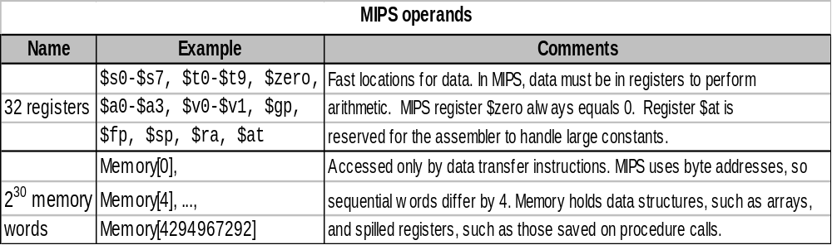
To summarize:

Slide 32
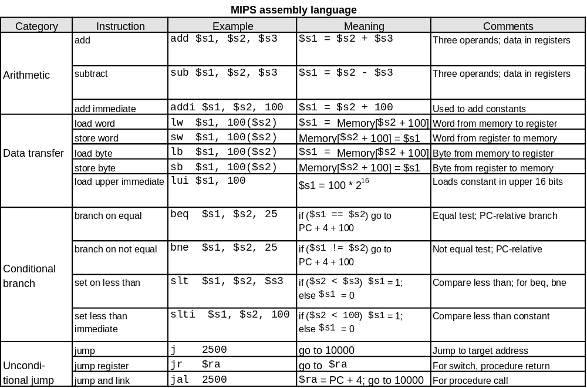
To summarize:

Slide 33
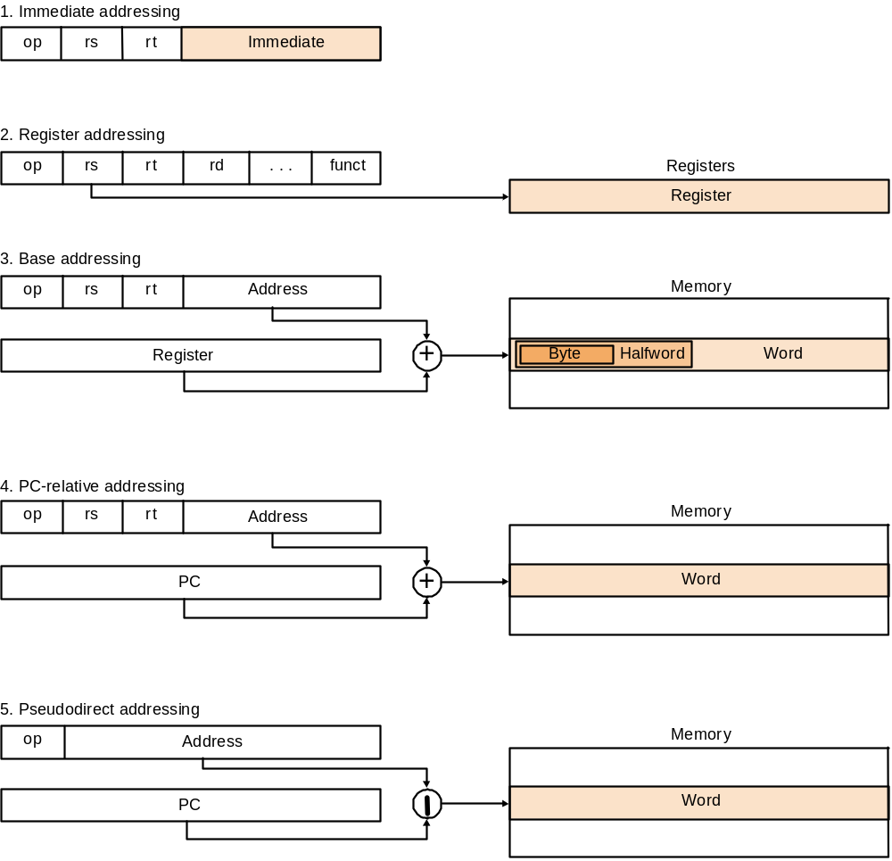
MIPS addressing modes summary

Slide 34
Alternative Architectures
Design alternative:
  provide more powerful operations
  goal is to reduce number of instructions executed
  danger is a slower cycle time and/or a higher CPI
Sometimes referred to as “RISC vs. CISC” debate
  virtually all new instruction sets since 1982 have been RISC
  VAX: minimize code size, make assembly language easy
  instructions from 1 to 54 bytes long!
We’ll look at PowerPC and 80x86

Slide 35
PowerPC
Indexed addressing
  example:
  lw $t1,$a0+$s3 #$t1=Memory[$a0+$s3]
  What do we have to do in MIPS?
Update addressing
  update a register as part of load (for marching through arrays)
  example:
  lwu $t0,4($s3) #$t0=Memory[$s3+4];$s3=$s3+4
  What do we have to do in MIPS?
Others:
  load multiple/store multiple
  a special counter register “bc Loop”
  decrement counter, if not 0 goto loop

Slide 36
A dominant architecture: x86/IA-32
Historic Highlights:
1978: The Intel 8086 is announced (16 bit architecture)
1980: The 8087 floating point coprocessor is added
1982: The 80286 increases address space to 24 bits, +instructions
1985: The 80386 extends to 32 bits, new addressing modes
1989-1995: The 80486, Pentium, Pentium Pro add a few
instructions (mostly designed for higher performance)
1997: Pentium II with MMX is added
1999: Pentium III, with 70 more SIMD instructions
2001: Pentium IV, very deep pipeline (20 stages) results in high freq.
2003: Pentium IV – Hyperthreading
2005: Multi-core solutions
2006: Adding virtualization support (AMD-V and Intel VT-x)
2010: AVX: Advanced vector ext.: SIMD using 16 256-bit registers

Slide 37
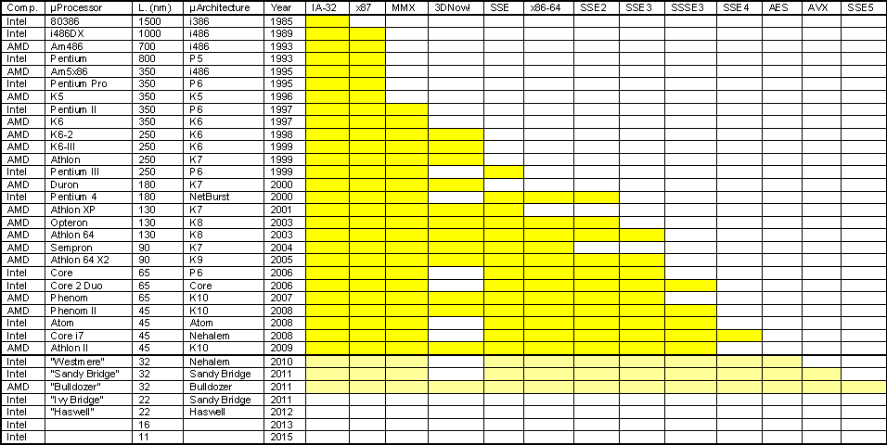
Historical overview

Slide 38
A dominant architecture: 80x86
See your textbook for a more detailed description
Complexity:
  Instructions from 1 to 17 bytes long
  one operand must act as both a source and destination
  one operand can come from memory
  complex addressing modes
  e.g., “base or scaled index with 8 or 32 bit displacement”
Saving grace:
  the most frequently used instructions are not too difficult to build
  compilers avoid the portions of the architecture that are slow
“what the 80x86 lacks in style is made up in quantity,
making it beautiful from the right perspective”

Slide 39
Summary (so far)
Instruction complexity is only one variable
  lower instruction count vs. higher CPI / lower clock rate
Design Principles:
  simplicity favors regularity
  smaller is faster
  good design demands compromise
  make the common case fast
Instruction set architecture
  a very important abstraction indeed!

Slide 40
More complex stuff
While statement
Case/Switch statement
Procedure
  leaf
  non-leaf / recursive
Stack
Memory layout
Characters, Strings
Arrays versus Pointers
Starting a program
  Linking object files

Slide 41
While statement
while (save[i] == k)
i=i+j;
Loop: muli $t1,$s3,4
add $t1,$t1,$s6
lw $t0,0($t1)
bne $t0,$s5,Exit
add $s3,$s3,$s4
j Loop
Exit:
# calculate address of
# save[i]

Slide 42
Case/Switch statement
C Code (pg 129):
switch (k) {
case 0: f=i+j; break;
case 1: ............;
case 2: ............;
case 3: ............;
}
Assembler Code:
Data: jump table
1. test if k inside 0-3
2. calculate address of jump table location
3. fetch jump address and jump
4. code for all different cases (with labels L0-L3)
address L0
address L1
address L2
address L3

Slide 43
Compiling a leaf Procedure
C code
int leaf_example (int g, int h, int i, int j)
{
int f;
f = (g+h)-(i+j);
return f;
}
Assembler code
leaf_example: save registers changed by callee
code for expression ‘f = ....’
(g is in $a0, h in $a1, etc.)
put return value in $v0
restore saved registers
jr $ra

Slide 44
Using a Stack
low address
Save $s0 and $s1:
subi $sp,$sp,8
sw $s0,4($sp)
sw $s1,0($sp)
empty
$sp
filled
Restore $s0 and $s1:
lw $s0,4($sp)
lw $s1,0($sp)
addi $sp,$sp,8
high address
Convention: $ti registers do not have to be saved and restored by callee
They are scratch registers

Slide 45
Compiling a non-leaf procedure
C code of ‘recursive’ factorial (pg 136)
int fact (int n)
{
if (n<1) return (1)
else return (n*fact(n-1));
}
Factorial: n! = n* (n-1)!
0! = 1

Slide 46
Compiling a non-leaf procedure
For non-leaf procedure
save arguments registers (if used)
save return address ($ra)
save callee used registers
create stack space for local arrays and structures (if any)

Slide 47
Compiling a non-leaf procedure
Assembler code for ‘fact’
fact: subi $sp,$sp,8 # save return address
sw $ra,4($sp) # and arg.register a0
sw $a0,0($sp)
slti $to,$a0,1 # test for n<1
beq $t0,$zero,L1 # if n>= 1 goto L1
addi $v0,$zero,1 # return 1
addi $sp,$sp,8 # check this !
jr $ra
L1: subi $a0,$a0,1
jal fact # call fact with (n-1)
lw $a0,0($sp) # restore return address
lw $ra,4($sp) # and a0 (in right order!)
addi $sp,$sp,8
mul $v0,$a0,$v0 # return n*fact(n-1)
jr $ra

Slide 48
How does the stack look?
low address
Caller:
$a0 = 0
$ra = ...
$a0 = 1
100 addi $a0,$zero,2
104 jal fact
108 ....
$ra = ...
$a0 = 2
$sp
$ra = 108
filled
Note: no callee regs are used
high address

Slide 49
Beyond numbers: characters
Characters are often represented using the ASCII standard
ASCII = American Standard COde for Information Interchange
See table 3.15, page 142
Note: value(a) - value(A) = 32
value(z) - value(Z) = 32

Slide 50
Beyond numbers: Strings
A string is a sequence of characters
Representation alternatives for “aap”:
  including length field: 3’a’’a’’p’
  separate length field
  delimiter at the end: ‘a’’a’’p’0 (Choice of language C !!)
Discuss C procedure ‘strcpy’
void strcpy (char x[], char y[])
{
int i;
i=0;
while ((x[i]=y[i]) != 0) /* copy and test byte */
i=i+1;
}

Slide 51
String copy: strcpy
strcpy: subi $sp,$sp,4
sw $s0,0($sp)
add $s0,$zero,$zero # i=0
L1: add $t1,$a1,$s0 # address of y[i]
lb $t2,0($t1) # load y[i] in $t2
add $t3,$a0,$s0 # similar address for x[i]
sb $t2,0($t3) # put y[i] into x[i]
addi $s0,$s0,1
bne $t2,$zero,L1 # if y[i]!=0 go to L1
lw $s0,0($sp) # restore old $s0
add1 $sp,$sp,4
jr $ra
Note: strcpy is a leaf-procedure; no saving of args
and return address required

Slide 52
Arrays versus pointers
Array version:
clear1 (int array[], int size)
{
int i;
for (i=0; i<size; i=i+1)
array[i]=0;
}
Two programs
which initialize
an array to zero
Pointer version:
clear2 (int *array, int size)
{
int *p;
for (p=&array[0]; p<&array[size]; p=p+1)
*p=0;
}

Slide 53
Arrays versus pointers
Compare the assembly result on page 174
Note the size of the loop body:
  Array version: 7 instructions
  Pointer version: 4 instructions
Pointer version much faster !
Clever compilers perform pointer conversion themselves

Slide 54
Starting a program
Compile C program
Assemble
Link
  insert library code
  determine addresses of data and instruction labels
  relocation: patch addresses
Load into memory
  load text (code)
  load data (global data)
  initialize $sp, $gp
  copy parameters to the main program onto the stack
  jump to ‘start-up’ routine
    copies parameters into $ai registers
    call main

Slide 55
Starting a program
C program
compiler
Assembly program
assembler
Object program (user module)
Object programs (library)
linker
Executable
loader
Memory

Slide 56
Exercises
Make from chapter three the following exercises:
  3.1 - 3.6
  3.8
  3.16 (calculate CPI for gcc only)
  3.19, 3.20

